Slide 1
Project 3:
Subreddit Posts Classification
Chia Xing Wei DSI16

Slide 2
Problem Statement
In a fast paced society, people have less time to read books and there is a growing trend observed in the amount of people listening to audiobooks instead.
A book publishing company is looking to publish a new audiobook. As reddit is a network of communities based on people's interests, two subreddits ‘r/audiobooks’ and 'r/booksuggestions' are chosen in order to understand readers interests in audiobooks.
Classification on subreddit’s posts
Get insights on reader’s interests from the posts

Slide 3


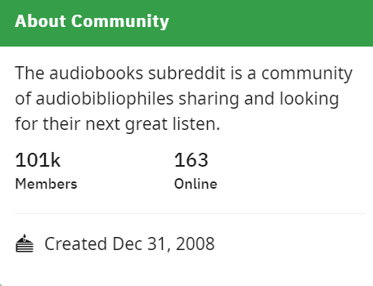
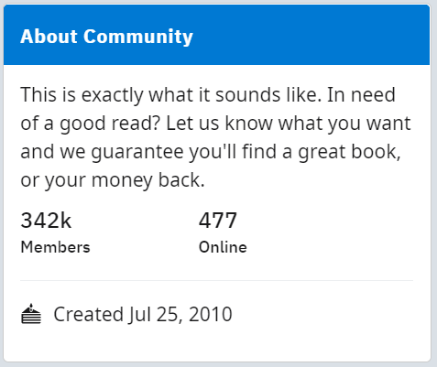
Subreddits

Slide 4
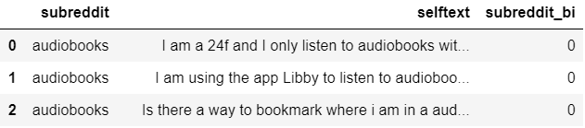
Data Collection
Web Scraping
Check for duplication and drop_duplication
Create a dataframe that only content the selftext of the post.
Convert subreddit into binary labels
audiobooks: 1 , booksuggestions : 0
Subreddit | audiobooks | booksuggestions
Total posts scrapped | 1238 | 1250
Total posts remained after drop duplicate | 688 | 651

Slide 5
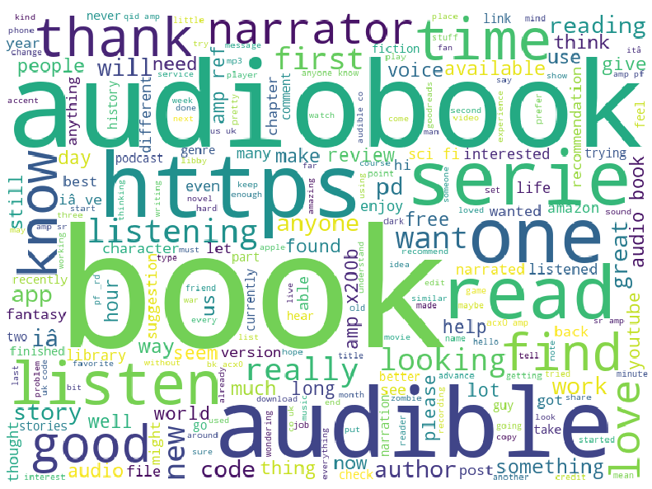
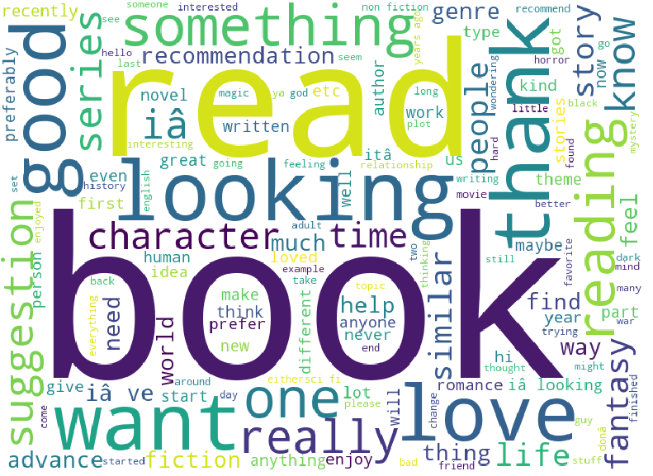
audiobook? booksuggestion?

Slide 6
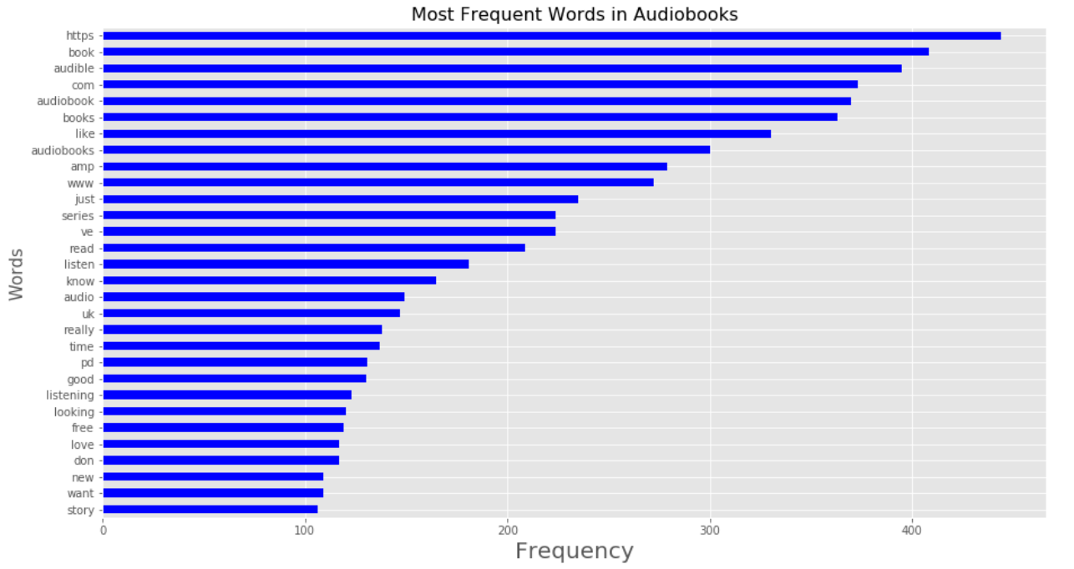
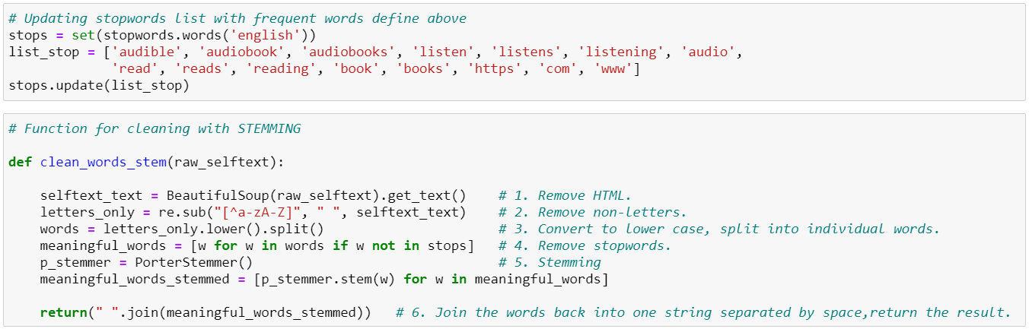
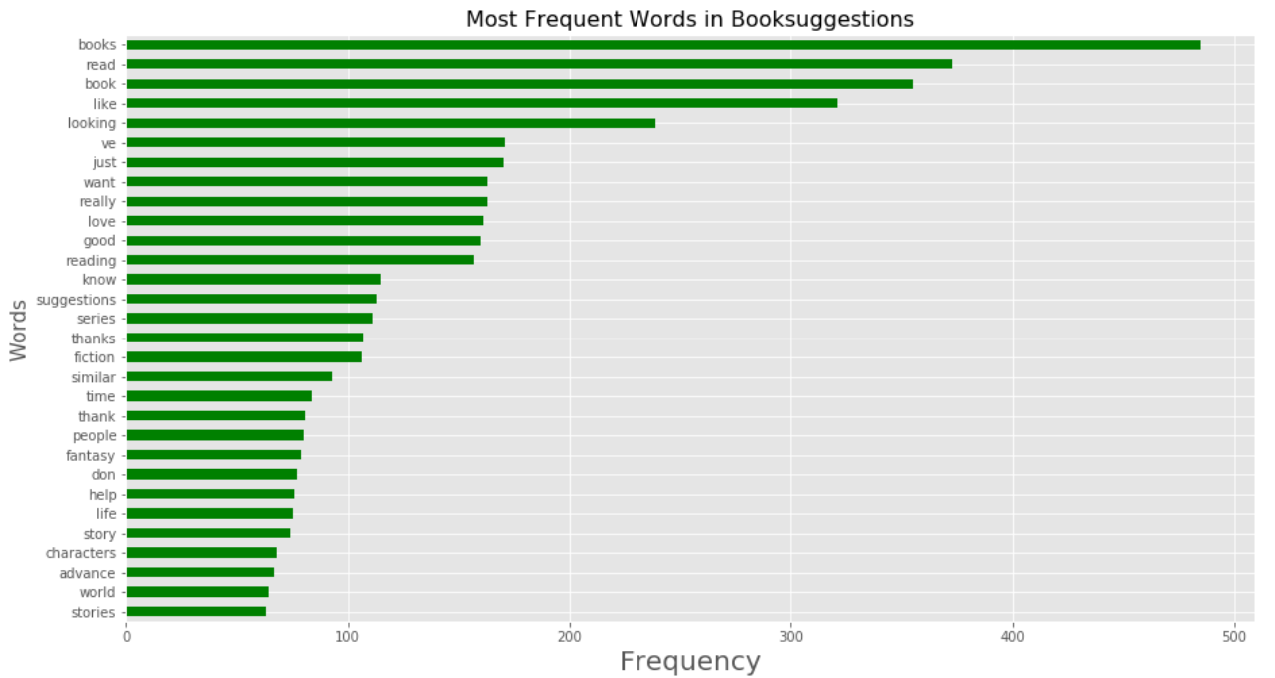
In order to not overfit or confuse the model, removed obvious words that appear frequently in only one subreddit

Slide 7
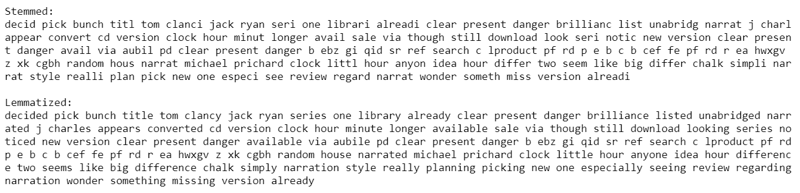
Data Cleaning
Stemming vs Lemmatization

Slide 8
Logistic Regression
K-Nearest Neighbors
Count Vectorizer
Best Model with Count Vectorizer
Multinomial Naive Bayes
Model & GridSearch Count Vectorizer
Best Model
Logistic Regression
K-Nearest Neighbors
TF-IDF Vectorizer
Best Model with TF-IDF Vectorizer
Multinomial Naive Bayes
Model & GridSearch TF-IDF Vectorizer

Slide 9
Models with Count Vectorizer
Model | Training Accuracy | Testing Accuracy
Logistic Regression | 0.8186 | 0.7761
K-Nearest Neighbors | 0.6808 | 0.6442
Multinomial Naive Bayes | 0.9252 | 0.8308
Multinomial Naive Bayes with GridSearh Count Vectorizer parameters | 0.9295 | 0.8208
Model 1

Slide 10
Models with TF-IDF Vectorizer
Model | Training Accuracy | Testing Accuracy
Logistic Regression | 0.5133 | 0.5149
K-Nearest Neighbors | 0.8111 | 0.8034
Multinomial Naive Bayes | 0.9594 | 0.8383
Multinomial Naive Bayes with GridSearh TF-IDF Vectorizer parameters | 0.9328 | 0.8308
Model 2

Slide 11
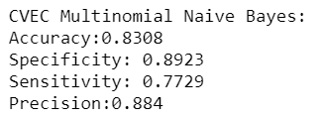
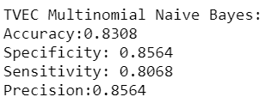
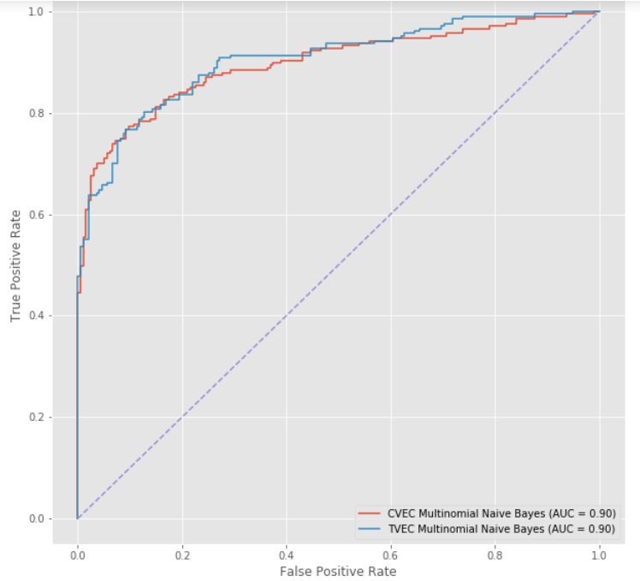
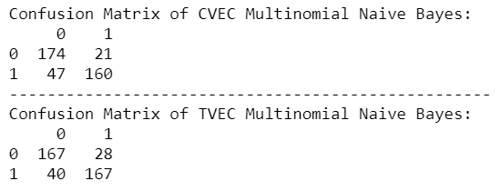
Model 1 vs Model 2
Best Model: Multinomial Naive Bayes with GridSearh TF-IDF Vectorizer parameters

Slide 12
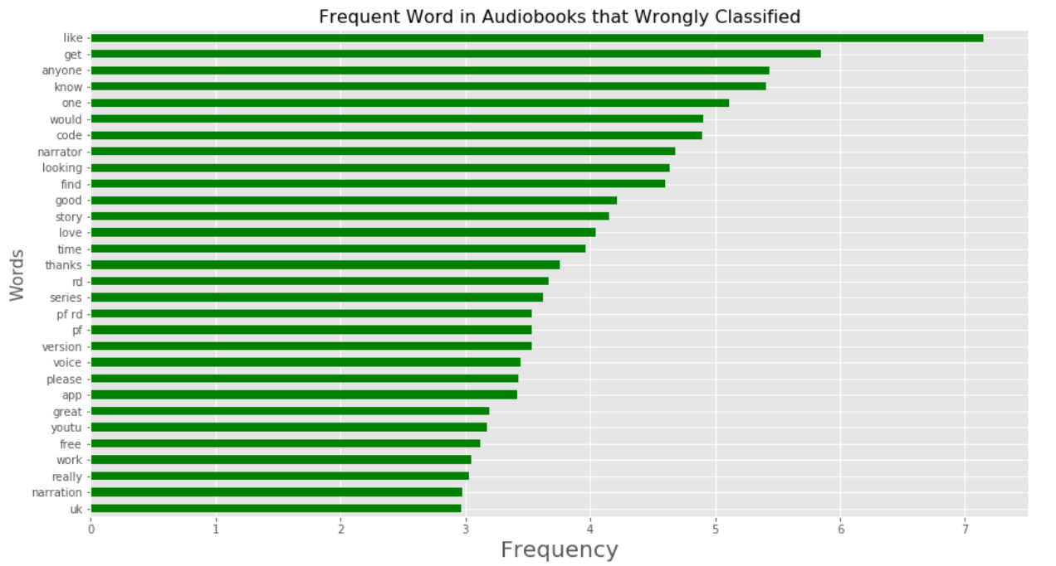
Wrong Classification
Similar words as frequently appear words in both subreddits which might lead to confusion for the model
The model can be further improved by removing more words that frequently appear in both subreddits so that the model can be train with more unique words from each subreddit.

Slide 13
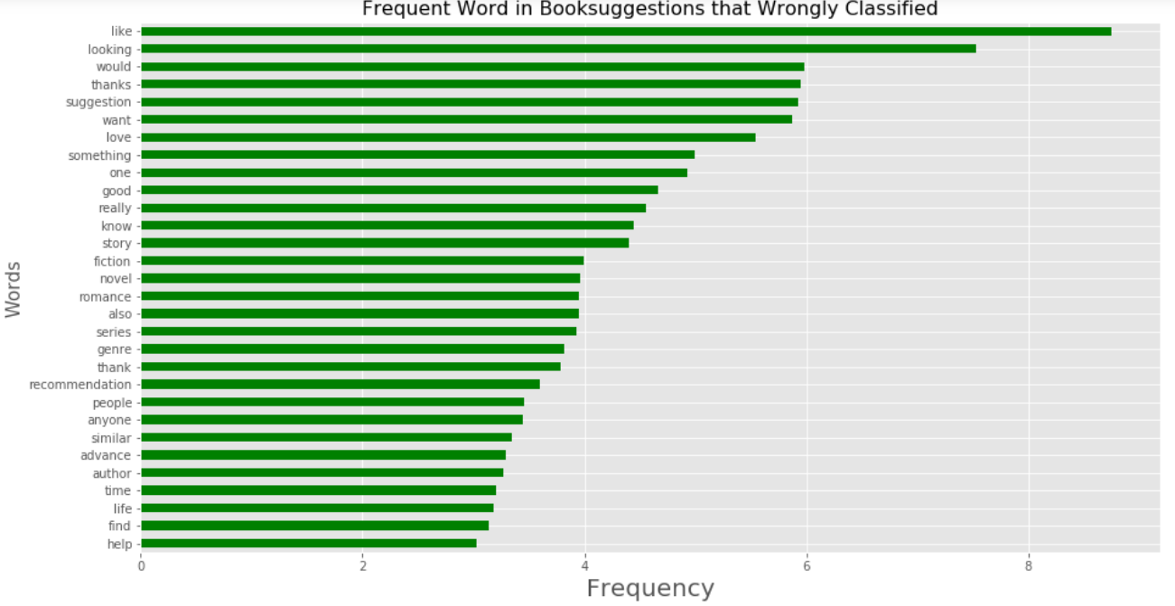
Wrong Classification
Similar words as frequently appear words in both subreddits which might lead to confusion for the model
The model can be further improved by removing more words that frequently appear in both subreddits so that the model can be train with more unique words from each subreddit.

Slide 14
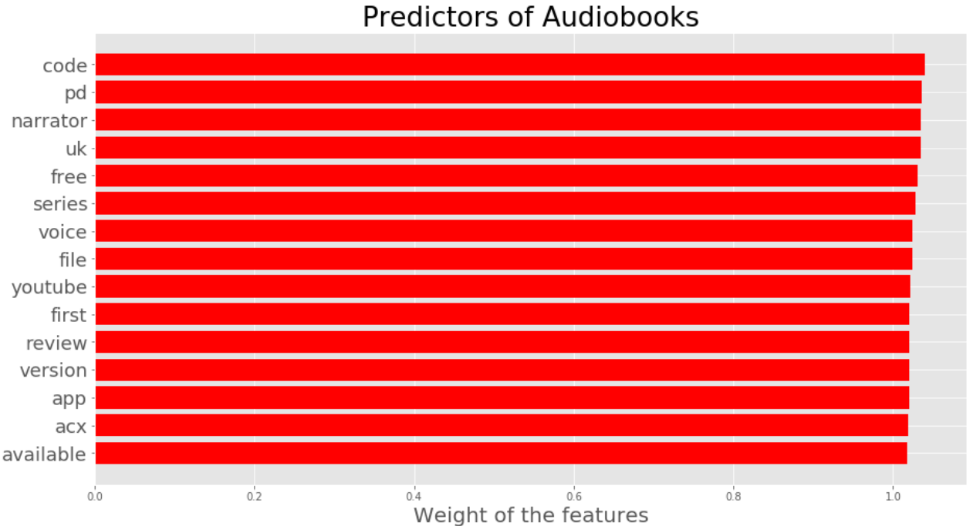
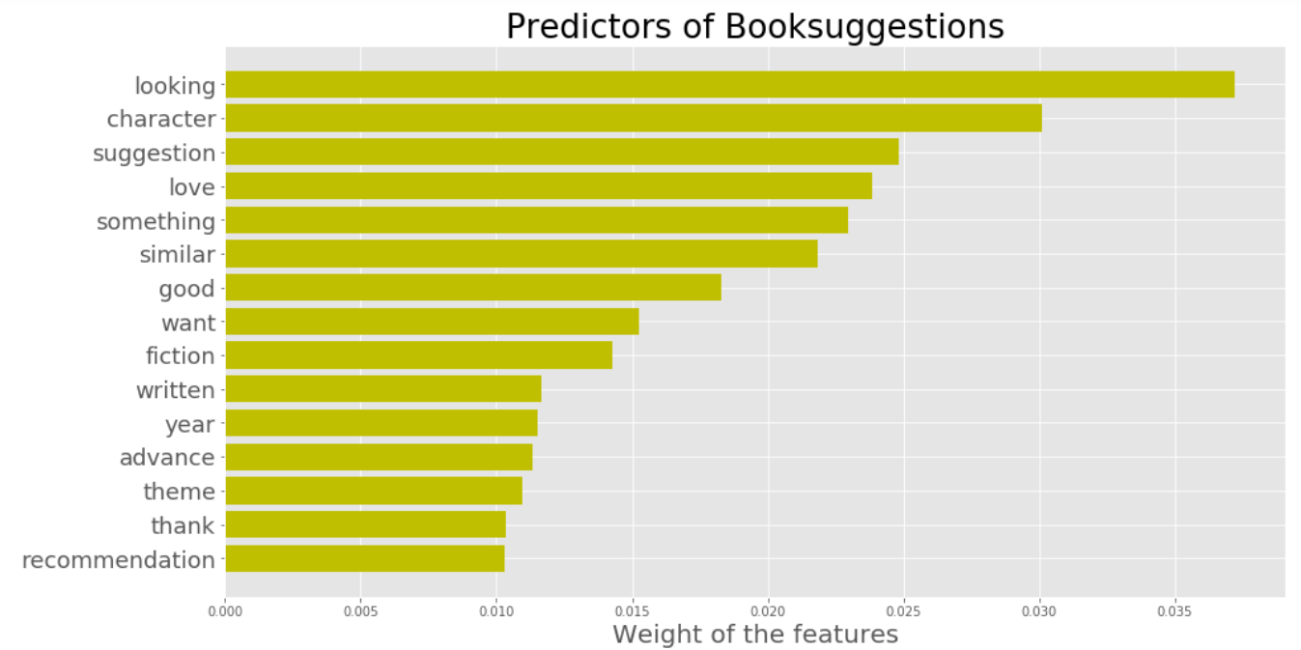
Recommendation
1. If the publisher is going to publish an audiobook, the most used audiobook website would be Audible.Thus, publishing at the website would be ideal to reach out to more people.
2. Words like 'Narrator' and 'free' did frequently appear in subreddit 'audiobooks' posts, this can be a hint for the publisher that the narrator's voice and the price of the audiobooks would be the main concern for readers.
3. As the word 'fiction' and 'love' appear to be the preditors of the subreddit 'booksuggestions', publishers can assume that the most popular genres is fiction, non-fiction or love.
4. As the community in 'booksuggestions' are usually asking for recommendations or suggestions of good books, the sales and marketing team can consider joining the community to advertise new published books by the company.

